Slide 1
MIMIC Visualization Assignment details

Slide 2
Two types
V1_DataVisualization_Akshay.ipynb
Github link: https://github.com/akshayuta/MIMIC-visualization/blob/main/V1_DataVisualization_Akshay.ipynb
Google colab link: https://colab.research.google.com/drive/1jPewTRjvmstjjtHcocl0GMlbK0d-NJdX?usp=sharing
This file contains assignment done as per what teacher has shown. Only difference is the data that is imported is full data and not a demo data.
V2_DataVisualization_Akshay.ipynb:
Github link: https://github.com/akshayuta/MIMIC-visualization/blob/main/V2_DataVisualization_Akshay.ipynb
Google colab link: https://colab.research.google.com/drive/186emFZLxzosaOXWHXy-vsd-i5Gz732_6?usp=sharing
This file contains assignment done using MIMIC data and used differrent tables and charts.

Slide 3
V2_DataVisualization_Akshay.ipynb
Data prep done:
Uploaded patients, admission, drugcodes tables data

Slide 4
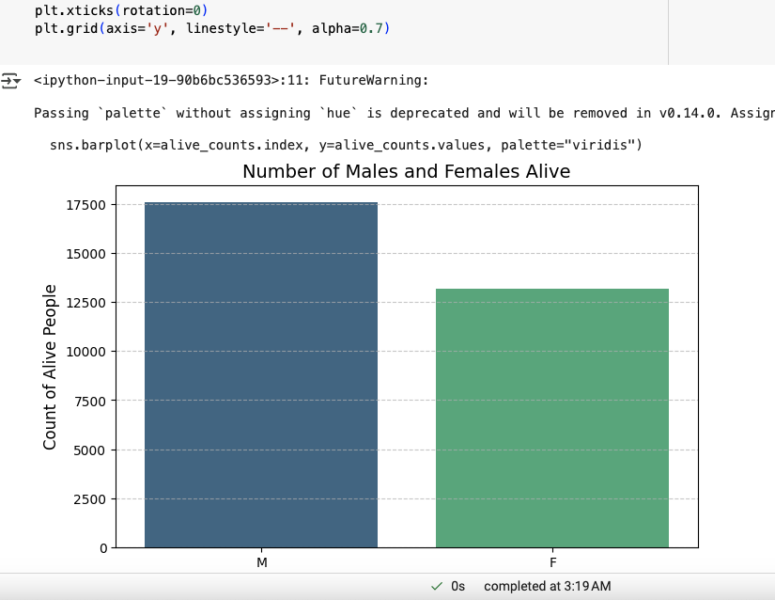
Visualization 1
Created chart with number of Male and female alive by filtering patients table column ’EXPIRE_FLAG’ == 0

Slide 5
Visualization 2
Created chart with number of Male and female alive by filtering patients table column ’EXPIRE_FLAG’ == 0
Steps followed
Added age column in patients dataframe
Merged patients and admission column using SUBJECT_ID
Created a countplot by Admission location by Gender

Slide 6
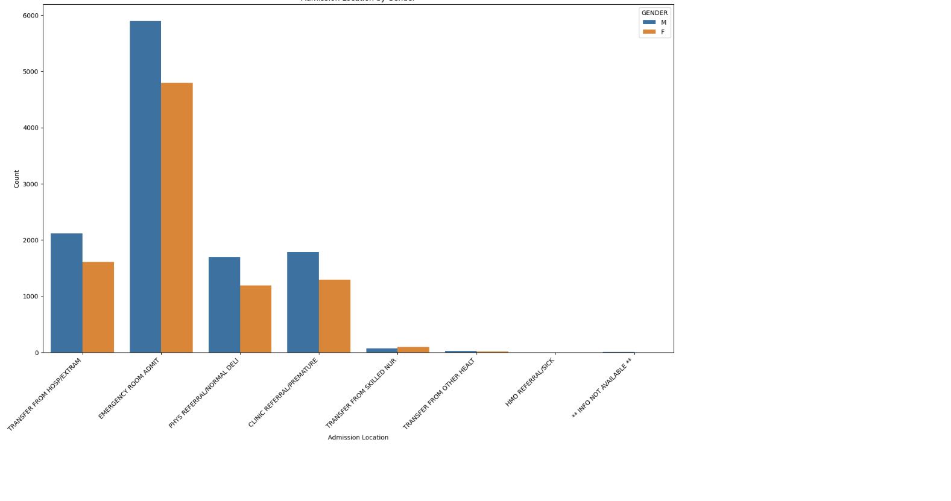

Slide 7
Visualization 3
Created Kernel density estimate plot
Trends in Male Patient Counts Over Time by Insurance Type
Trends in Female Patient Counts Over Time by Insurance Type
Steps followed
Converted ADMITTIME to datetime and added in merged_data dataframe
Filtered male data and stored in male_data dataframe
Filtered female data and stored in female_data dataframe
On x axis provided ADMITTIME and on y axis provided INSURANCE

Slide 8
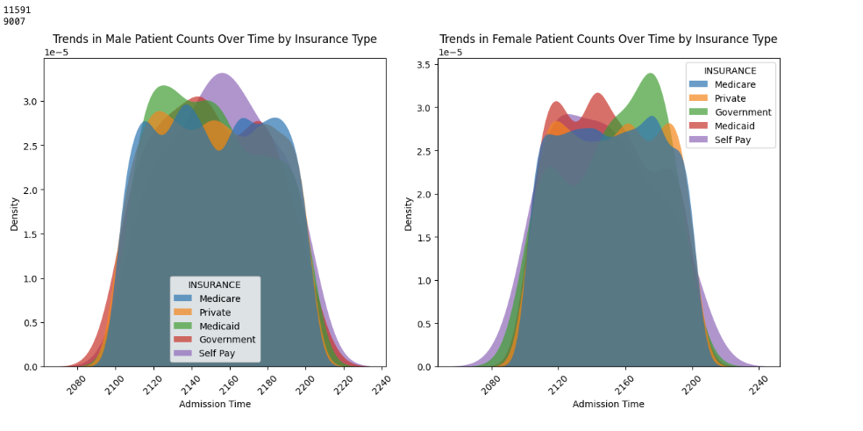

Slide 9
Visualization 4
Created bar plot
Top 10 Drug Codes for Male Subjects
Top 10 Drug Codes for Female Subjects
Steps followed
Created a dictionary from drugCodes table where index was DRG_CODE and value was DESCRIPTION
Merged patients table and drugCodes table
Created dataframe for top 10 drug codes for male and female
On x axis provided DRG_CODE and on y axis provided DESCRIPTION USING dictionary from step 1

Slide 10
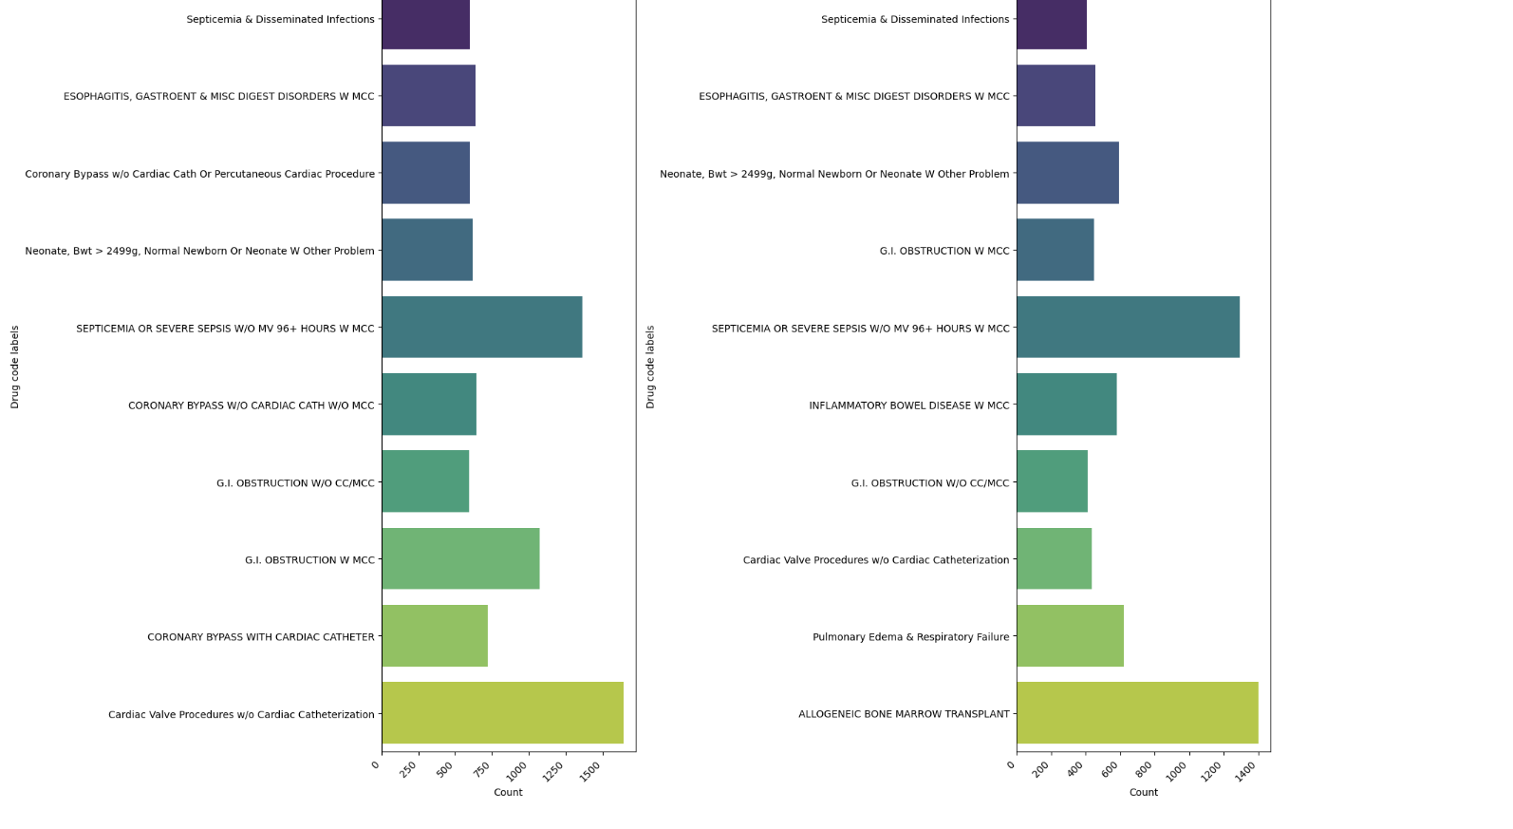

Slide 11
Visualization 5
Created Hovertext(Treee map)
Top 10 Drug Codes for Male Subjects
Top 10 Drug Codes for Female Subjects
Steps followed
Created a dictionary from drugCodes table where index was DRG_CODE and value was DESCRIPTION
Merged patients table and drugCodes table
Created dataframe for top 10 drug codes for male and female
Created a male and female dataframe containing drug_code, count and label as columns
Created another column called hover_text using drug_code, count and label as columns
Created a Treemap for male and female and if you hover on the chart, it showed drug description, drug code and count

Slide 12
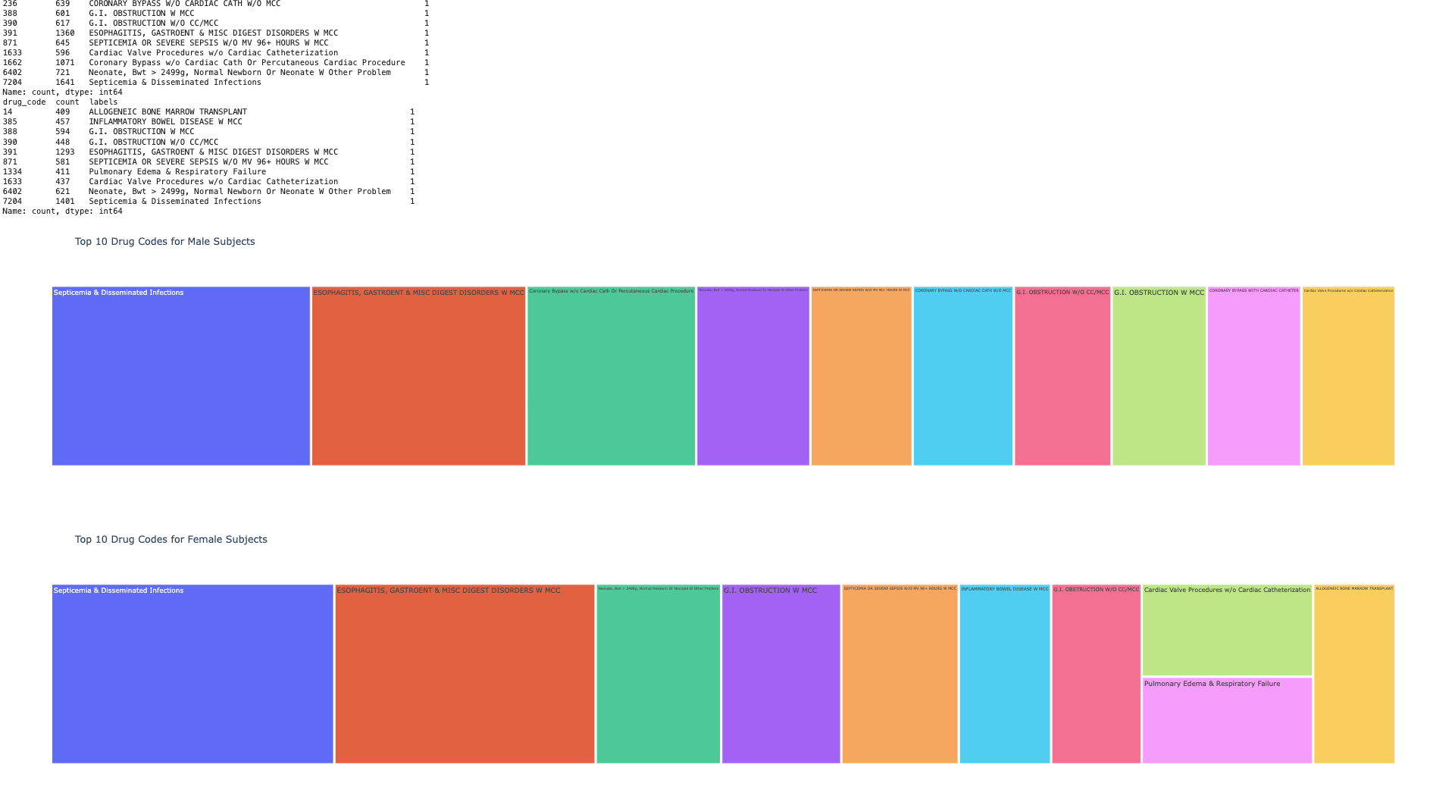

Slide 13
Visualization 6
Created Timeplot for callout data
Steps followed
Loaded top 100 records
Converted CREATTIME into date time
Converted ACKNOWLEDGETIME into date time
Created Ack_Duration column by substracting CREATTIME and ACKNOWLEDGETIME and dividing result by 3600 to convert to hours
On x axis passed CREATTIME and on y axis passed Ack_Duration

Slide 14
